Slide 1


Intuitive University Navigation System
This presentation proposes an intuitive navigation system for university websites. The aim is to streamline the process for students seeking academic resources, thereby improving their overall user experience. By implementing user-friendly design principles and effective categorization of information, we can ensure that students spend less time searching and more time focusing on their studies.

Slide 2


Current Navigation Challenges
Complexity of Existing Systems
Inconsistent Layouts
Limited Search Functionality
Navigating intricate website structures can overwhelm users.
Diverse designs across departments hinder resource discovery.
Ineffective search tools complicate users' search experiences.

Slide 3



Proposed Navigation Features
Search Filters and Recommendations
2
Introduce advanced search functionalities with customizable filters, aiding students in refining their searches and receiving personalized resource suggestions based on their profiles.
User-Centric Design
Implement a user-friendly interface tailored to students' needs, emphasizing ease of navigation and straightforward access to important academic resources.
1
Visual Navigation Elements
Utilize visually appealing elements like icons and intuitive menus, which guide students effectively while also engaging a younger demographic increasingly reliant on visual cues online.
3

Slide 4


Integration of Academic Resources
Centralized Resource Hub
Establish a centralized hub where students can find links to all academic resources.
Interactive Maps
Incorporate interactive campus maps for better navigation.
Mobile Compatibility
Ensure the system is mobile-responsive for on-the-go access.

Slide 5
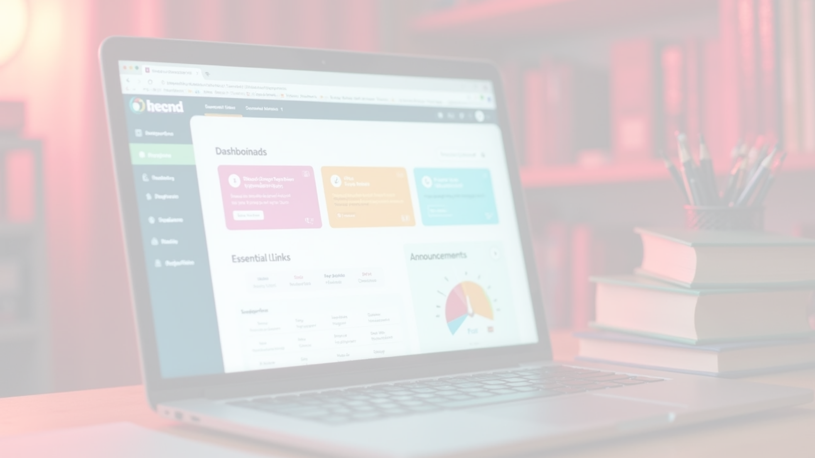

Enhancements for Personalization
User Profiles and Custom Dashboards
Feedback Mechanism
Gamification Elements
Include mechanisms for user feedback and suggestions, permitting continual optimization of the navigation system based on real student experiences and needs.
Introduce gamification features, rewarding users for exploring different sections of the site, thereby encouraging full utilization of available resources in a fun way.
Allow students to create personal profiles with tailored dashboards that highlight essential departmental links, upcoming deadlines, and announcements relevant to their studies.

Slide 6



Implementation Strategy
1
2
3
Phase 1: Research and Development
Phase 2: Development and Launch
Phase 3: Continuous Improvement
Conduct surveys and focus groups to identify navigation challenges and design features.
Collaborate to create a prototype and conduct usability testing with students.
Establish ongoing evaluations and updates based on user feedback.

Slide 7



Conclusion and Impact
Enhanced User Experience
Increased Resource Engagement
Positive Institutional Image
An intuitive navigation system will significantly improve user experience, allowing students to quickly access academic resources and reducing frustration.
By facilitating easier access to resources, students are more likely to engage with academic tools, enhancing their educational outcomes.
A well-designed navigation system reflects positively on the university, showcasing a commitment to student support and innovative digital solutions.

